Slide 1
Video Game Sales
Genre, trends, and regional differences
Research Question: How do recorded video game sales vary by genre, over time, and across regions?
By: Naveed Ahmad
DATA 110 | Project 1

Slide 2
What does the dataset contain?
16,598
11
12
1980–2020
records / rows
columns
game genres
release years recorded
Key variables:
Genre and platform identify the type of game and where it was released.
NA, EU, Japan, Other, and Global Sales record sales in millions of units.

Slide 3
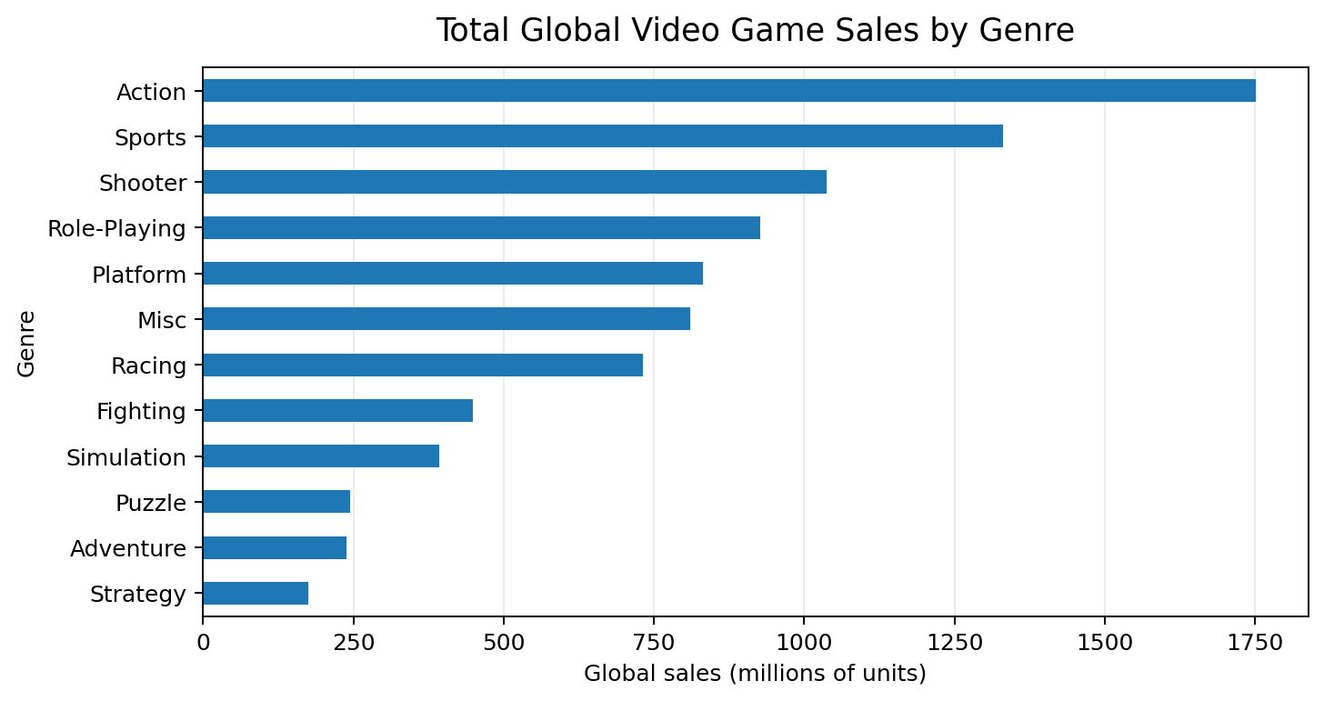
Action games led recorded global sales
Finding one
MAIN TAKEAWAY
Action
1,751.2 million units
Action is the highest-selling genre in the dataset, followed by Sports and Shooter.
Total global sales summed across all game records by genre.

Slide 4
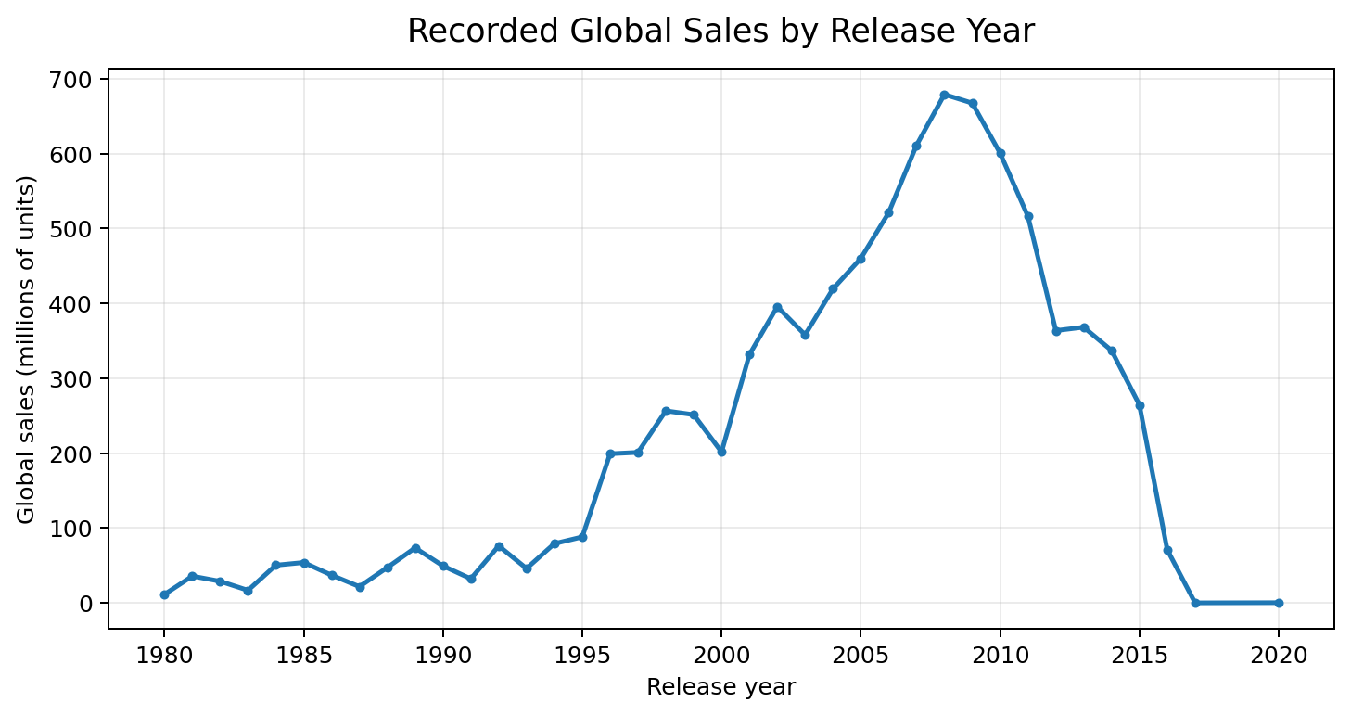
Recorded sales peak in 2008
Finding two
PEAK YEAR IN THIS DATASET
2008
678.9 million units
The recorded annual total is highest in 2008, with high totals also appearing in nearby years.
Global sales are summed for games with a recorded release year.

Slide 5
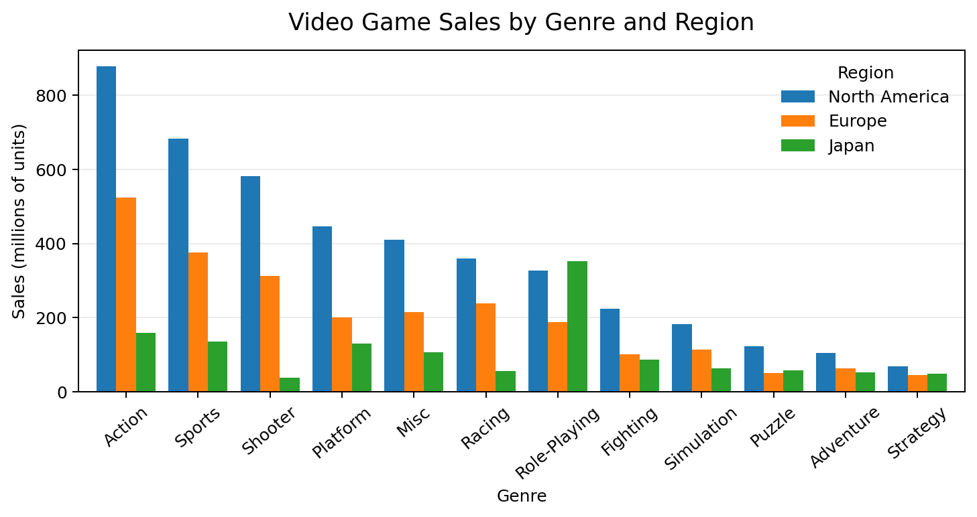
Regional sales patterns differ by genre
Finding three
REGIONAL EXAMPLES
North America
Action: 877.8M
Europe
Action: 525.0M
Japan
Role-Playing: 352.3M
The strongest genre varies by region; Japan shows a particularly strong Role-Playing total.
Regional totals are shown for North America, Europe, and Japan; Other_Sales is not included in this chart.

Slide 6
Conclusion
Three things the data suggests
01
Genre
Action games have the highest total recorded global sales.
02
Time
The largest recorded annual total occurs in 2008.
03
Region
Sales patterns differ across regions; Role-Playing is especially prominent in Japan.
Limitation: these findings describe this dataset’s recorded sales and may not represent the complete market.

Slide 7
Sources:
Kaggle, “video game sales” search results — https://www.kaggle.com/datasets?search=video+game+sales

